Slide 1
Large Language Models
Jian Tang
HEC Montreal
Mila-Quebec AI Institute
Email: jian.tang@hec.ca

Slide 2
Outline
BERT
GPT3
Prompt Engineering
Fine-tuning
Open-source LLMs
ChatGPT
O1

Slide 3
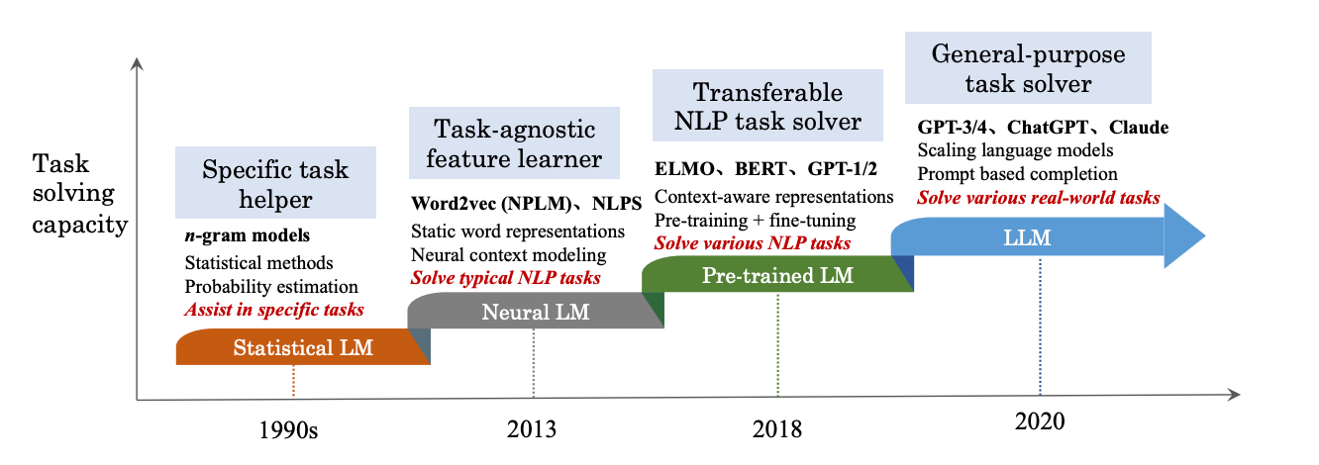
History of NLP Techniques

Slide 4


Natural Language Modeling
Given a text sequence $X=x_{1}x_{2}…x_{T}$, we want to model the joint distribution of
$X$ can be a sentence or a document
$$P\left(X\right)$$

Slide 5
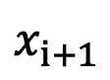
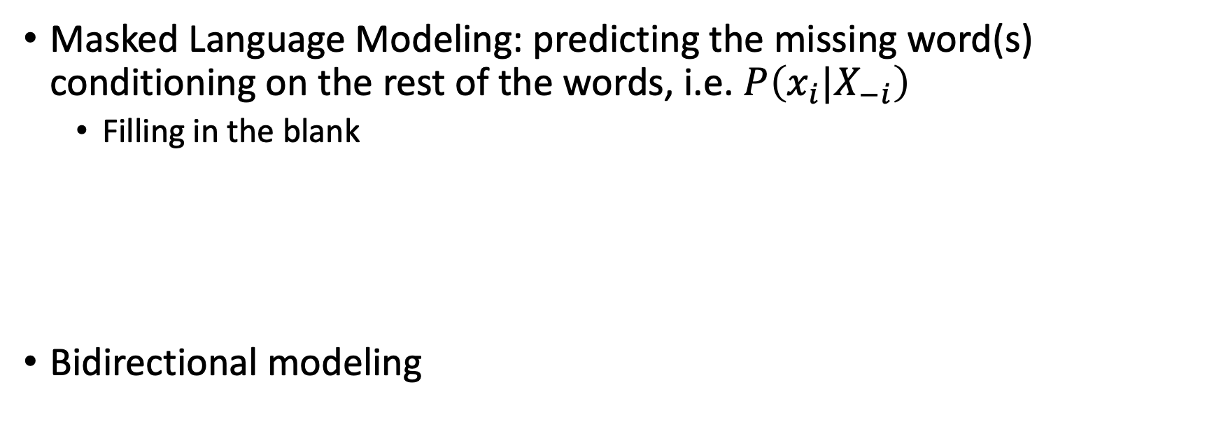
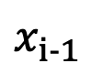





Two ways of Modeling$P\left(X\right)$
Masked Language Modeling: predicting the missing word(s) conditioning on the rest of the words, i.e. $P\left(x_{i}|X_{−i}\right)$
Filling in the blank
Bidirectional modeling
$$x_{1}$$
$$x_{2}$$
$$x_{3}$$
…
$$x_{i-1}$$
?
$$x_{i+1}$$
…
$$x_{T}$$

Slide 6
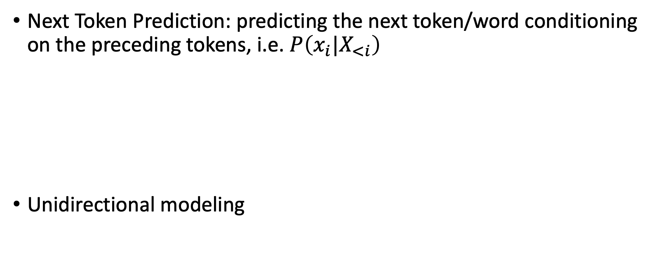
Two ways of Modeling$P\left(X\right)$
Next Token Prediction: predicting the next token/word conditioning on the preceding tokens, i.e. $P\left(x_{i}|X_{<i}\right)$
Unidirectional modeling
$$x_{1}$$
$$x_{2}$$
$$x_{3}$$
…
$$x_{i-1}$$
?

Slide 7
BERT: Pre-training of Deep Bidirectional Transformers for Language Understanding

Slide 8
BERT: Pre-training and Fine-Tuning Framework
Pre-train the model on unlabeled data over pre-training tasks
Initializing the model with the pre-trained parameters, and fine-tune all the parameters using labeled data from downstream tasks
Unified architecture across different tasks

Slide 9
Model Architecture
A multi-layer bidirectional Transformer encoder
BERT_BASE: Number of layers: 12, Hidden Size: 768, the number of self-attention heads: 12, total number of parameters: 110M
BERT_LARGE: Number of layers: 23, Hidden Size: 1024, the number of self-attention heads: 16, total number of parameters: 340M

Slide 10
Model Architecture
Input/Output Representations
Representation of whole sentence
Both a single sentence and a pair of sentences are represented in one token sequence
Start with a special token [CLS]
Separate sentences with a special token [SEP]
Add a learned embeddings to every token indicating whether it belongs to sentence A or sentence B

Slide 11
Input Representation
Each token embedding is the summation of token embedding, segment embedding, and position embeddings.

Slide 12
Pre-training BERT
Task #1: Masked LM
Mask some percentages of the input tokens at random, and then predict those masked tokens.
15% of the tokens in each sequence are masked out at random

Slide 13
Pre-training BERT
Task #2: Next Sentence Prediction (NSP)
Important in many downstream tasks such as question answering (QA) and natural language inference (NLI)
50% sentence pairs (A,B) are positive
Actually sentence B that follows A
50% sentence pairs (A, B) are negative
Randomly select a sentence B from the training corpus

Slide 14
Pre-training Data
BookCorpus (800M words)
English Wikipedia(2,500M words)

Slide 15
Fine-Tuning BERT
Sentence Pair Classification Tasks, e.g., nature language inference
Given a pair of sentences, the goal is to predict whether the second sentence is an entailment, contradiction, or neutral w.r.t. the first one

Slide 16
Fine-Tuning BERT
Sentence Classification

Slide 17
Fine-Tuning BERT
Question Answering

Slide 18
Fine-Tuning BERT
Sentence Tagging

Slide 19
Experimental Results
GLUE: General Language Understanding Evaluation Benchmark

Slide 20
Ablation Study
LTR: left-to-right, unidirectional language modeling

Slide 21
Effect of Model Size
L: number of layers
H: hidden dimension
A: number of self-attention heads

Slide 22
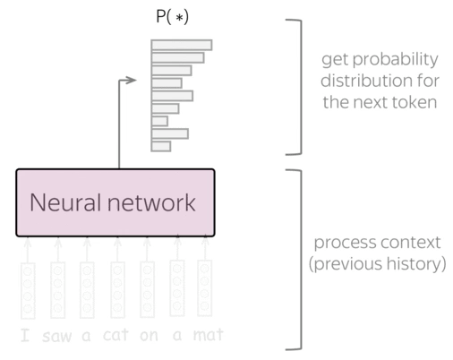
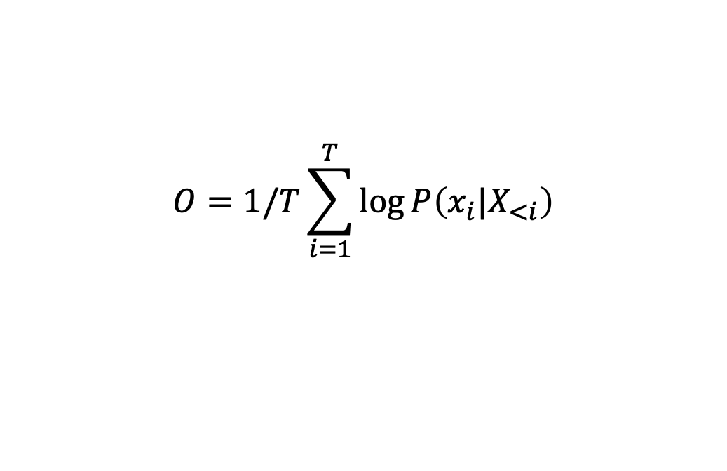
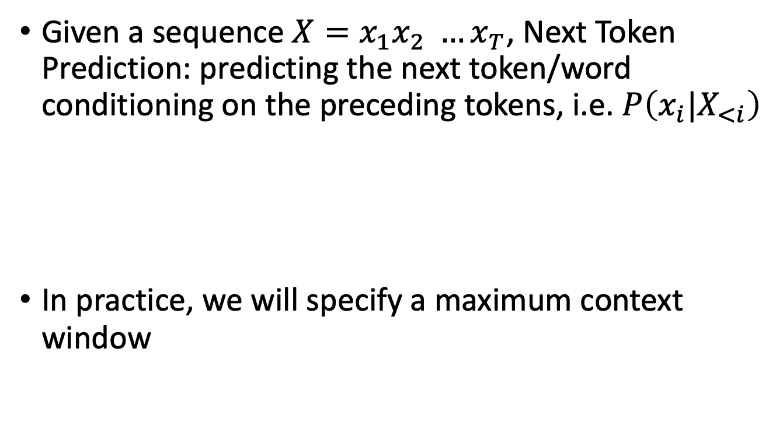
Large Language Models
Given a sequence ${X=x}_{1}x_{2} …x_{T}$, Next Token Prediction: predicting the next token/word conditioning on the preceding tokens, i.e. $P\left(x_{i}|X_{<i}\right)$
In practice, we will specify a maximum context window
$$O=1/T\sum_{i=1}^{T}{\log{P\left(x_{i}|X_{<i}\right)}}$$
https://lena-voita.github.io/nlp_course/language_modeling.html

Slide 23
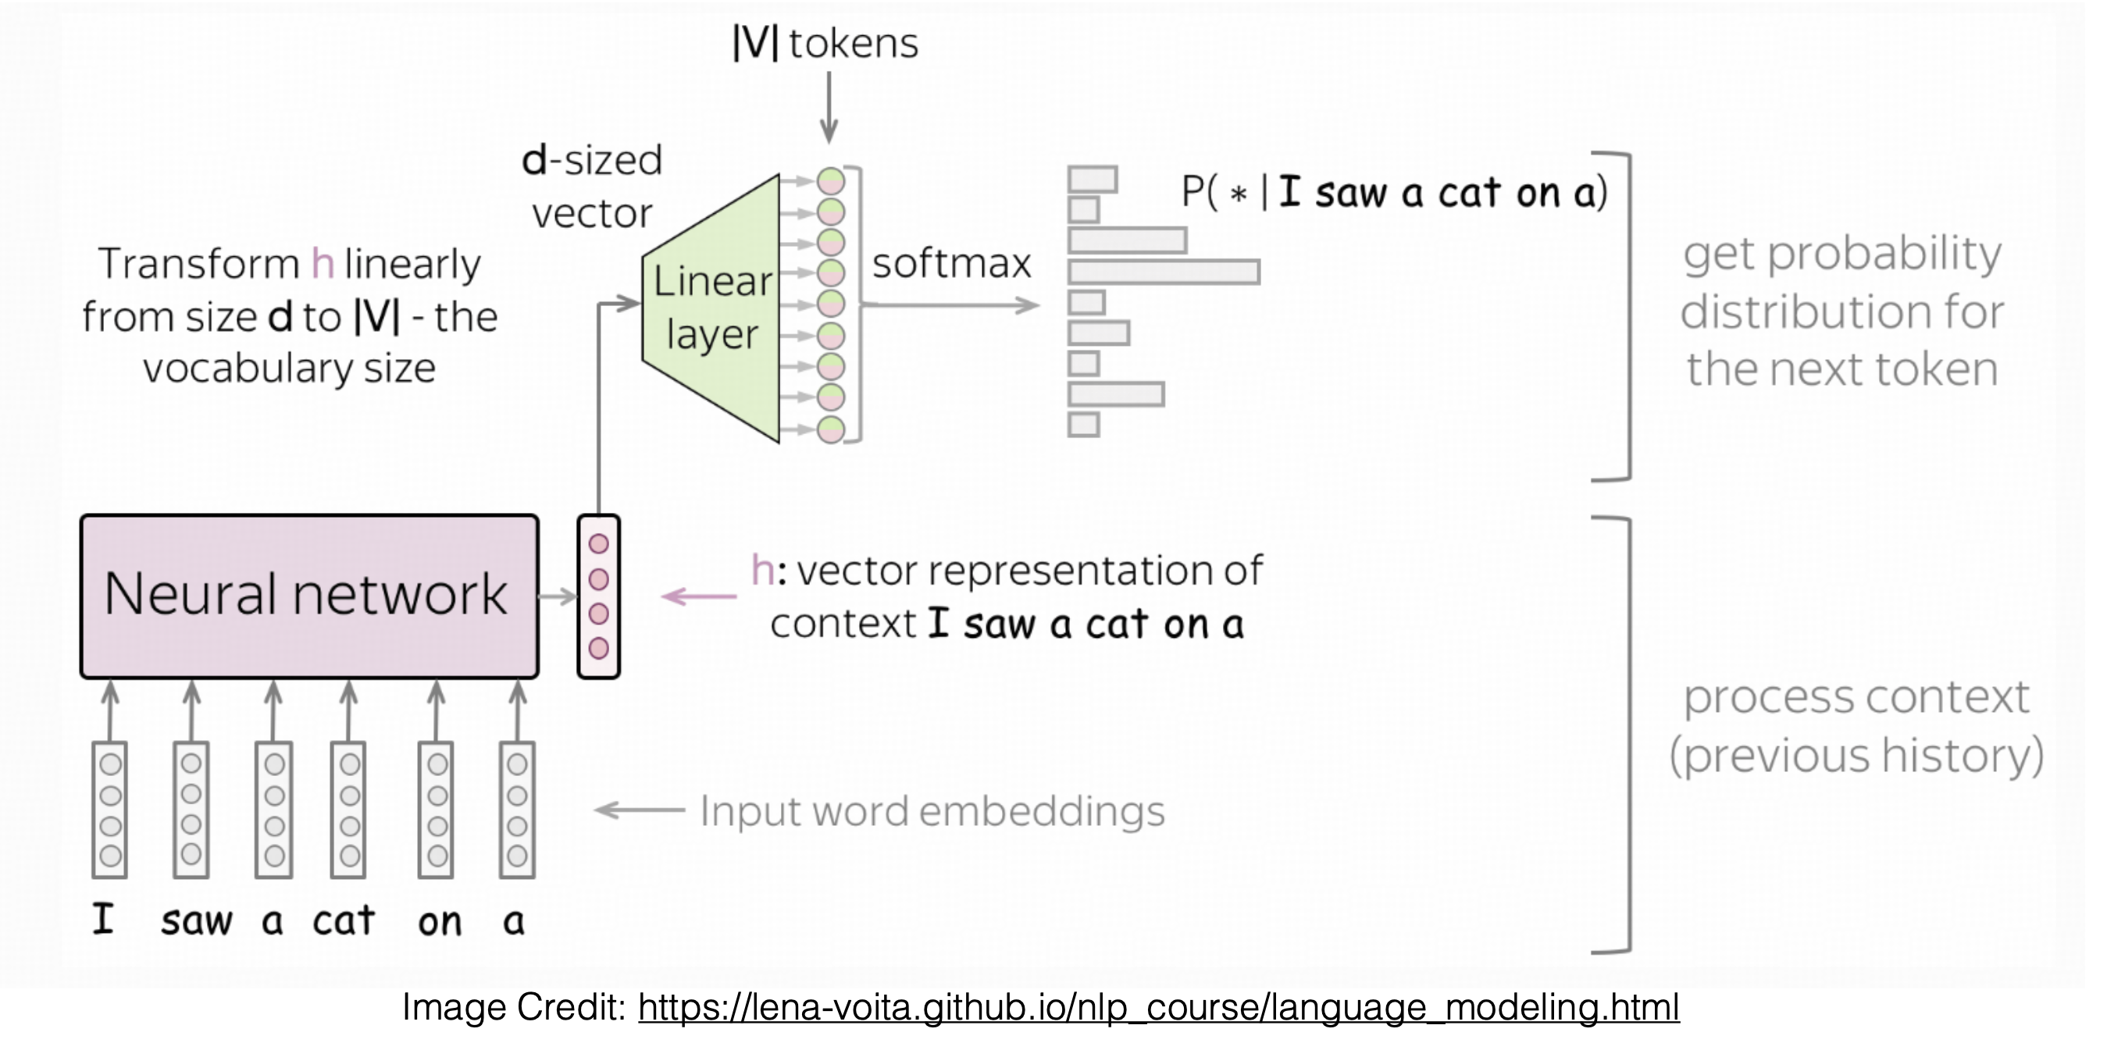
Next Token Prediction
Essentially learning a mapping function f: context -> word
a classification problem

Slide 24
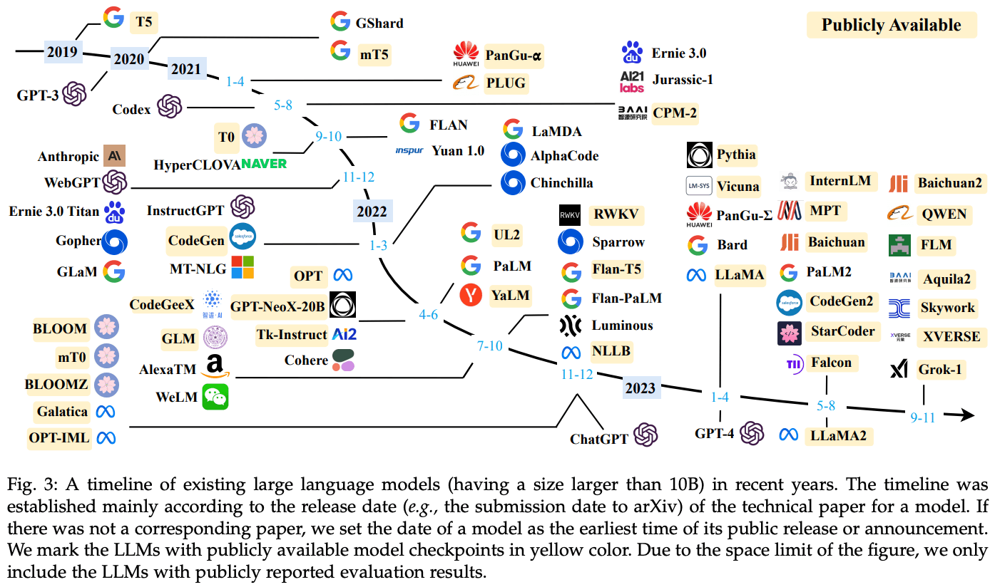
History of Generative LLMs
Figure from https://klu.ai/glossary/large-language-model

Slide 25
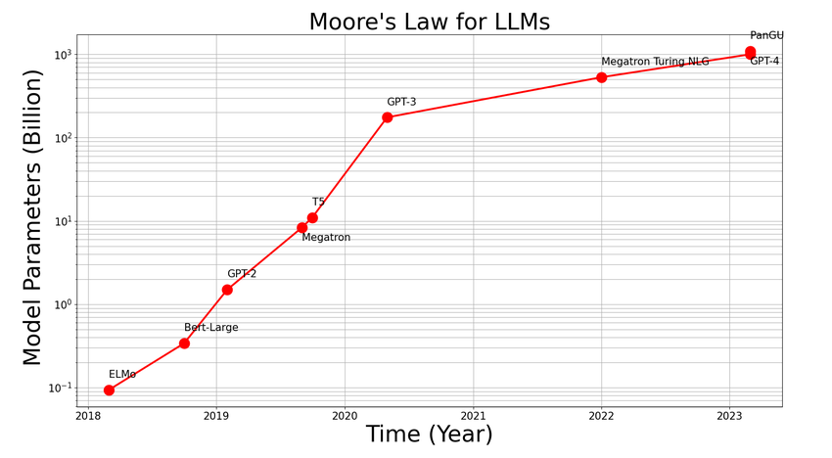
Mode Size over Time

Slide 26
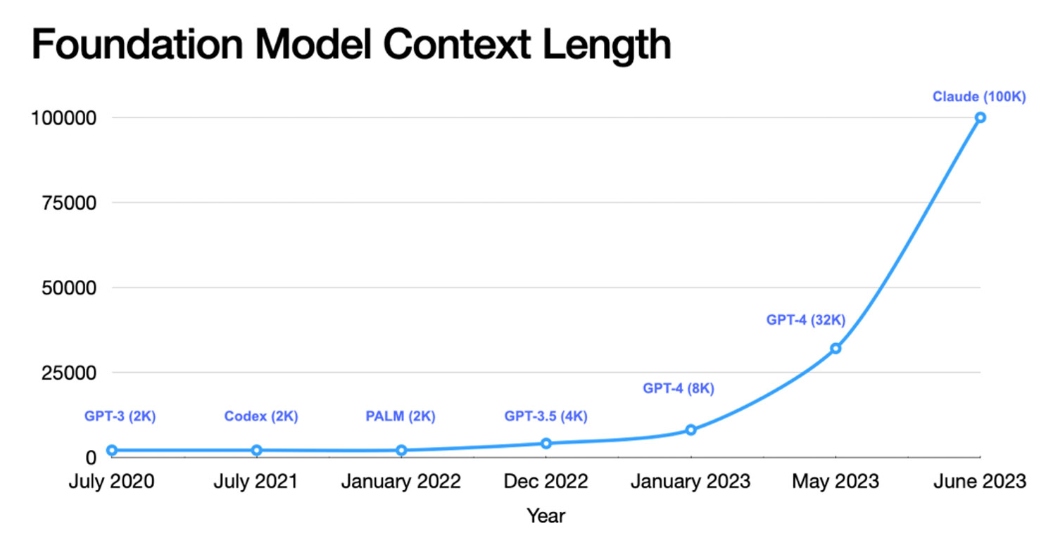
Context Size over Time
Figure from https://cerebras.ai/machine-learning/variable-sequence-length-training-for-long-context-large-language-models/

Slide 27
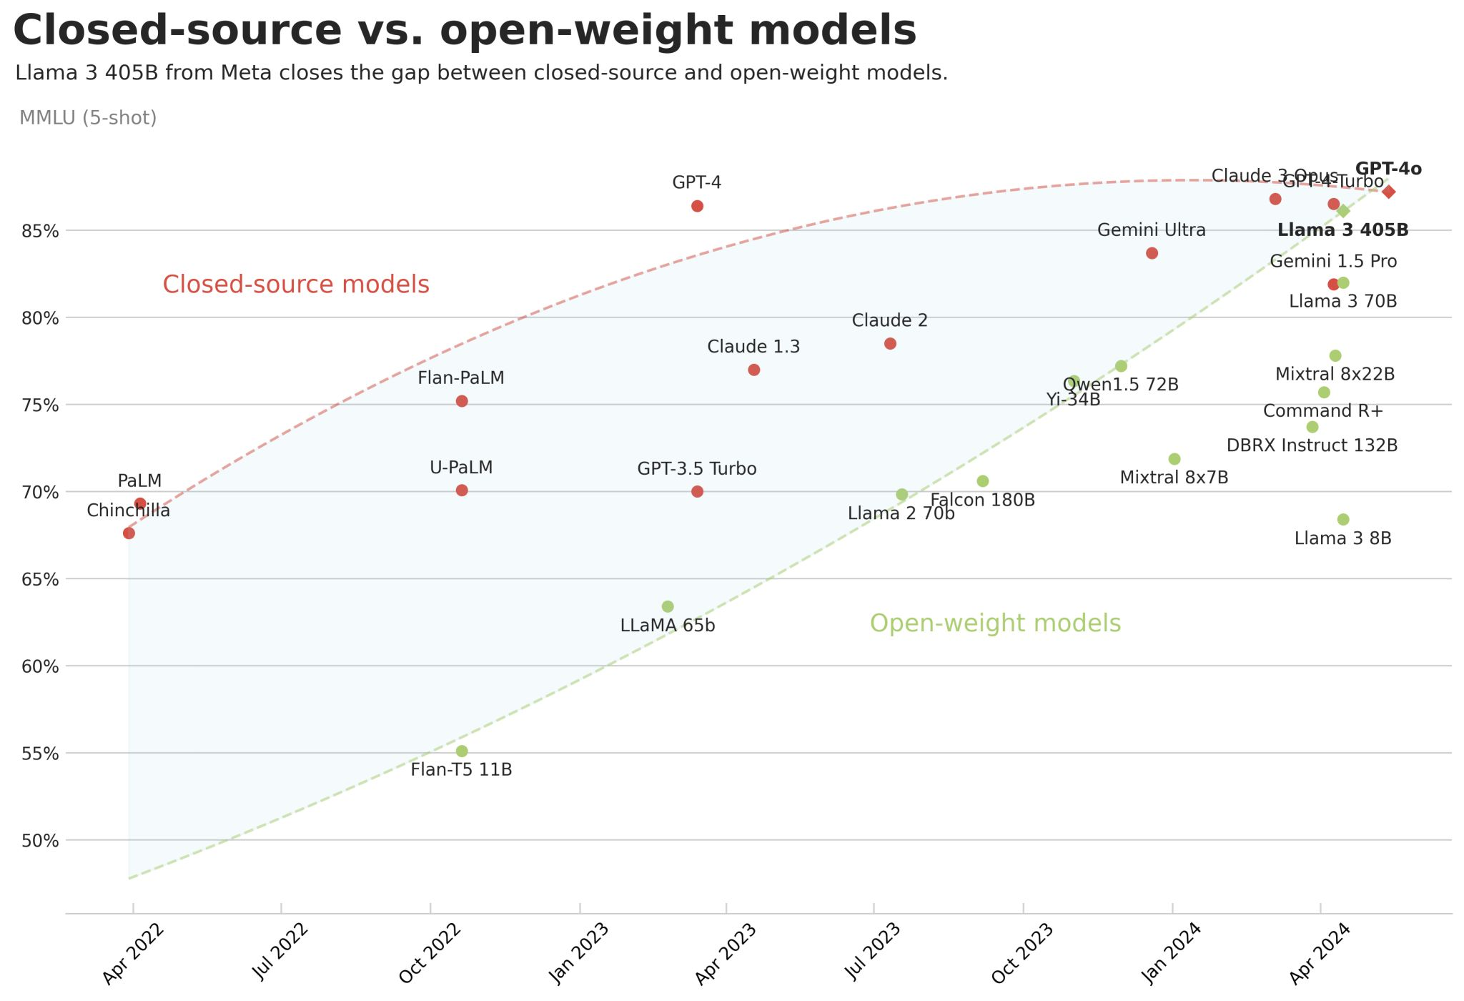
Open vs Closed LLMs

Slide 28



Closed-Source LLMs
GPT4/GPT 4o/ o1
Gemini
Claude 3

Slide 29
Open-source LLMs
Open source/reproducible：
Pythia: fully open, many sizes/checkpoints
OLMO: possibly strongest reproducible model
Open weights
Llama 1/2/3/3.1/3.2: most popular, heavily safety tuned
Mistral/Mixtral: strong and fast model, several European languages
Qiwen: strong, more multilingual – particularly en/zh
Slides borrowed from:

Slide 30
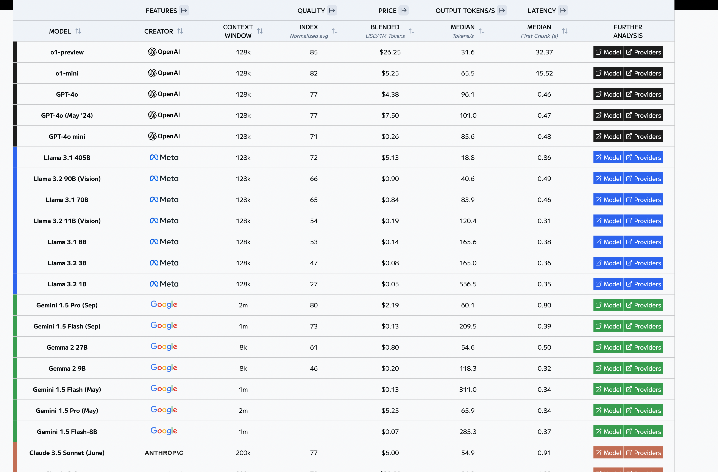
LLM Leaderboard: https://artificialanalysis.ai/leaderboards/models

Slide 31
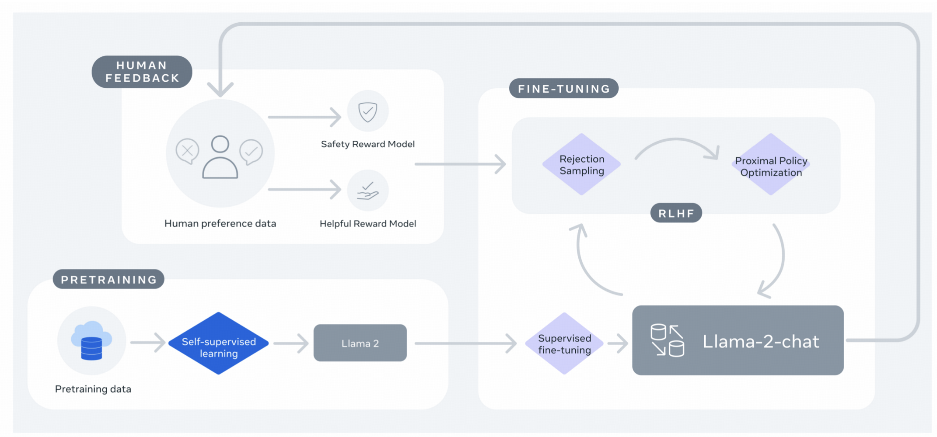
Overview of LLMs Training
Pretraining -> Supervised Fine-tuning (SFT) -> Reinforcement Learning Human Feedback (RLHF)

Slide 32

Pre-training Data

Slide 33
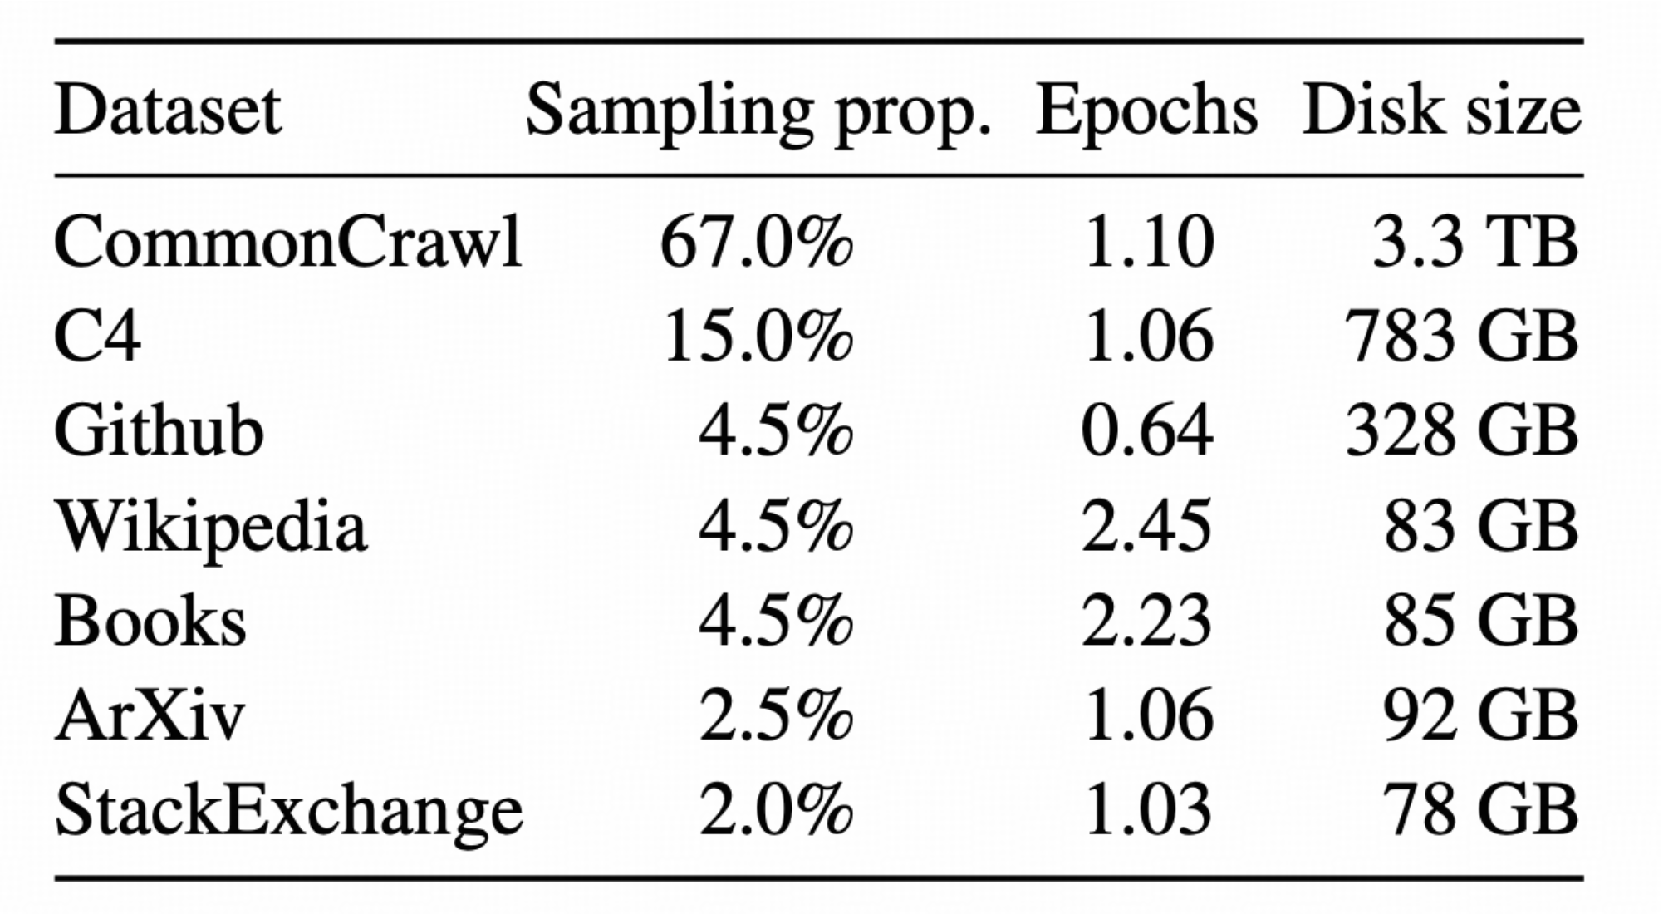
Example: Llama1
1.4 Trillion Tokens!!

Slide 34
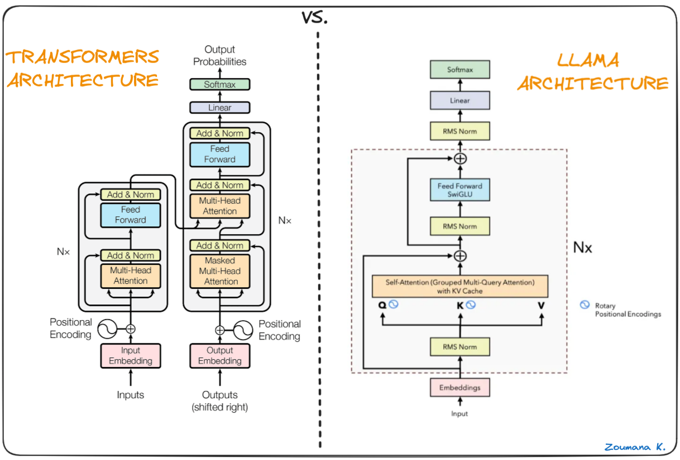
LlaMa Architecture
https://medium.com/@pranjalkhadka/llama-explained-a70e71e706e9
LLaMA:OpenandEfficient Foundation Language Models (https://arxiv.org/pdf/2302.13971)

Slide 35
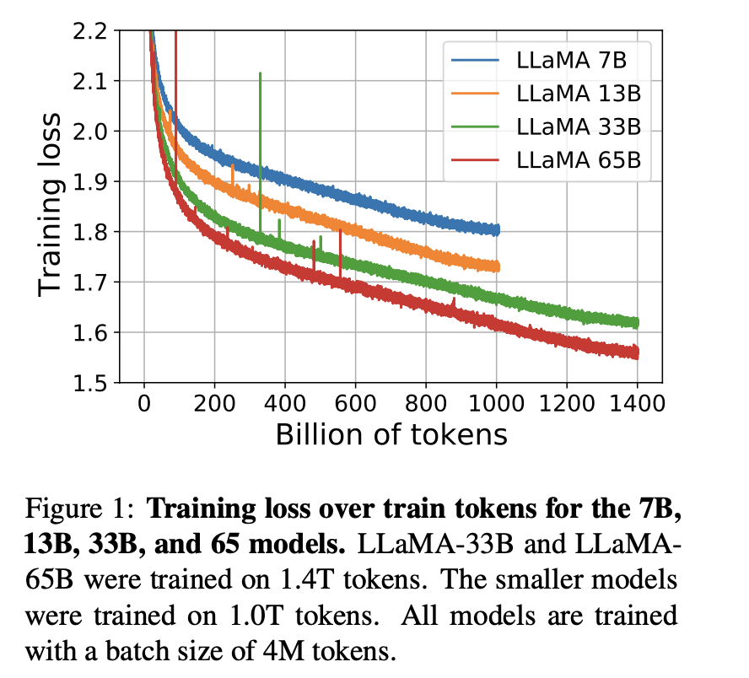
Training Loss

Slide 36

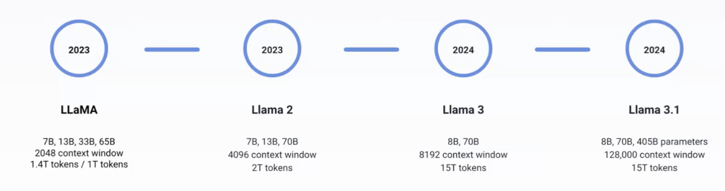
Llama (https://www.llama.com/)
Play with Llama: https://www.meta.ai/?utm_source=llama_meta_site&utm_medium=web&utm_content=Llama_nav&utm_campaign=July_moment

Slide 37
LoRa:
Efficient fine-tuning

Slide 38
Fine-tuning Llama 2 in Google Colab
https://colab.research.google.com/drive/1wbPpB3fY9YRzebrZq6WkP5HxMuHMQR72?usp=sharing

Slide 39
Different tasks in Natural Language Understanding

Slide 40
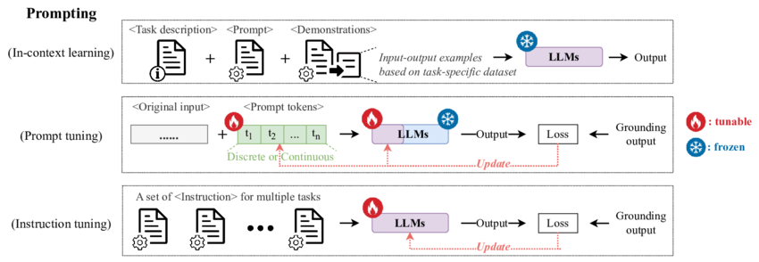

Slide 41
Thanks!

